Slide 1
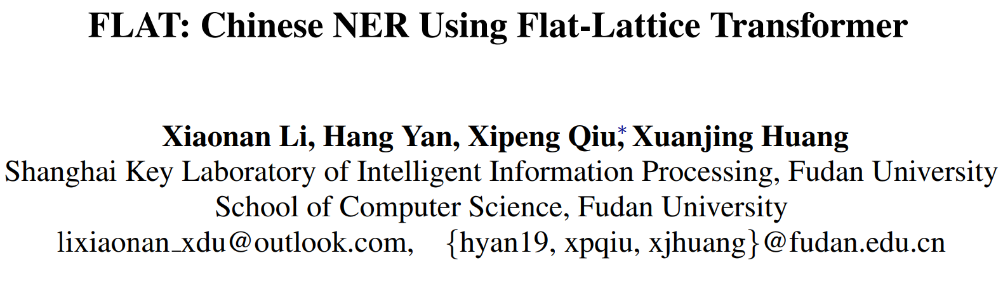
FLAT: Chinese NER Using Flat-Lattice Transformer
2021/10/14

Slide 2
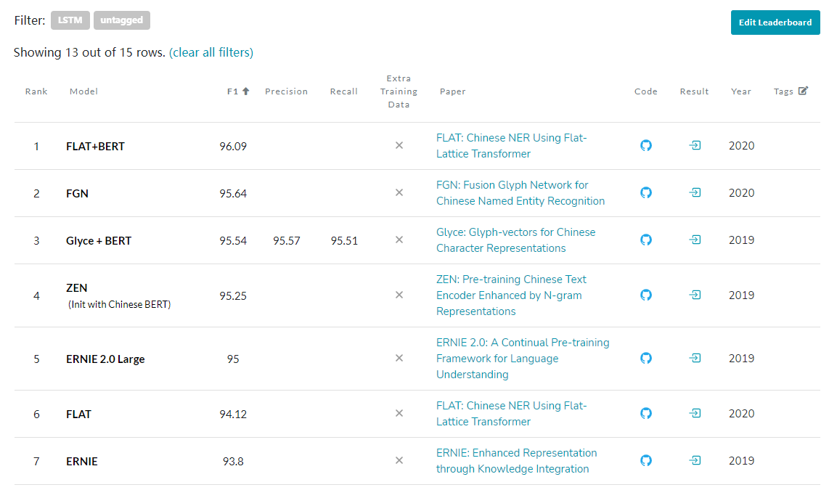
在MSRA-NER任务中，FLAT+BERT位列榜首（不需要额外训练数据的排名）；而单独的FLAT（1层TransFormer）也超越了预训练模型ERNIE。

Slide 3
Introduction
基于Transformer 设计了一种巧妙position encoding来融合Lattice结构，可以无损的引入词汇信息。
基于Transformer 融合了词汇信息的动态结构，实验结果表明，该模型优于其他基于词典的方法；支持并行化计算，可以大幅提升推理速度。
Transformer的自注意机制使字符能够直接与任何潜在单词交互，包括自匹配单词。
药 (Drug)的自匹配单词:人和药店(Renhe Pharmacy)和 药店 (Pharmacy)

Slide 4
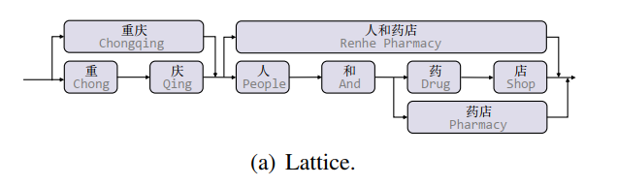
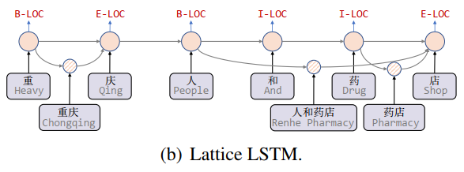
Introduction
Lattice LSTM这篇论文，这是针对中文NER任务引入词汇信息的开篇之作。
文中提出了一种Lattice LSTM用于融合词汇信息；避免了由分词造成的误差传播。
如图(a)所示，当我们通过词汇信息（词典）匹配一个句子时，可以获得一个类似Lattice的结构。
格是一个有向无环图，其中每个节点是一个字符或一个潜在单词。如图(b)。
有些词汇可能对于NER非常重要。
人和药店-重庆-重庆人
图，结点；注意力机制融合同一位置的不同结点。
Yue Zhang and Jie Yang. 2018. Chinese NER using lattice LSTM. CoRR, abs/1805.02023.

Slide 5
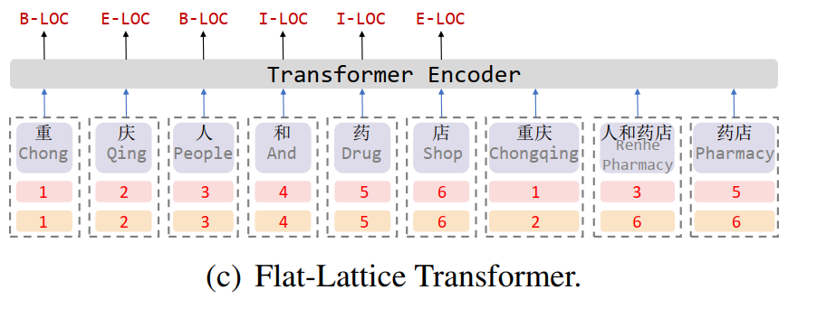
Model
Converting Lattice into Flat Structure
After getting a lattice from characters with a lexicon, we can flatten it into flat counterpart.
Transformation can maintain the original structure of lattice
flat-lattice： a set of spans
a span：corresponds to a token, a head and a tail
Notes:
the token which has the same head and tail, to construct the character sequence. Then we use other tokens (words) with their heads and tails to build skip-paths.
Since our transformation is recoverable, we assume flat-lattice can maintain the original structure of lattice

Slide 6
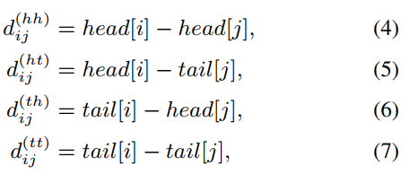


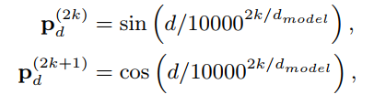
Model
Relative Position Encoding of Spans
四种相对位置关系可以表示xi和xj两个span的关系：
拼接、非线性变换得到相对位置编码：
Notes:
the token which has the same head and tail, to construct the character sequence. Then we use other tokens (words) with their heads and tails to build skip-paths.
Since our transformation is recoverable, we assume flat-lattice can maintain the original structure of lattice

Slide 7
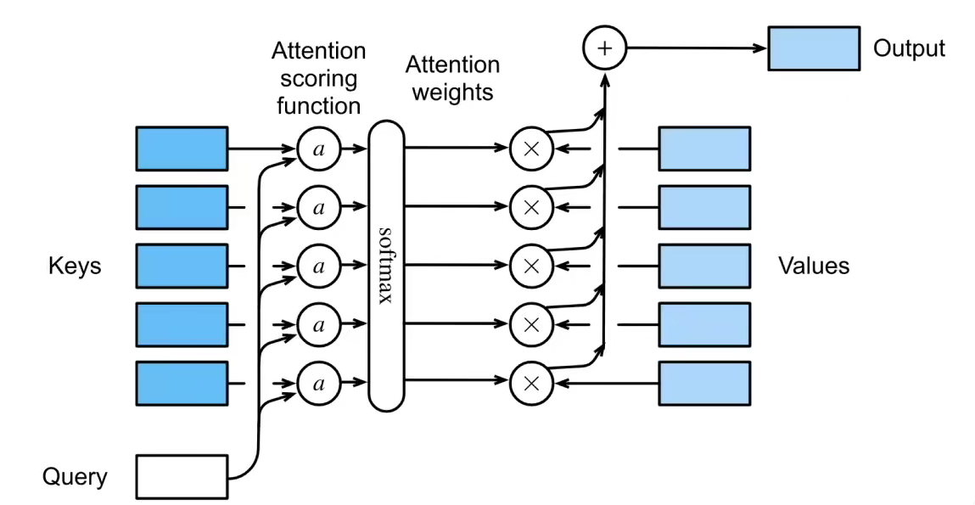

Slide 8
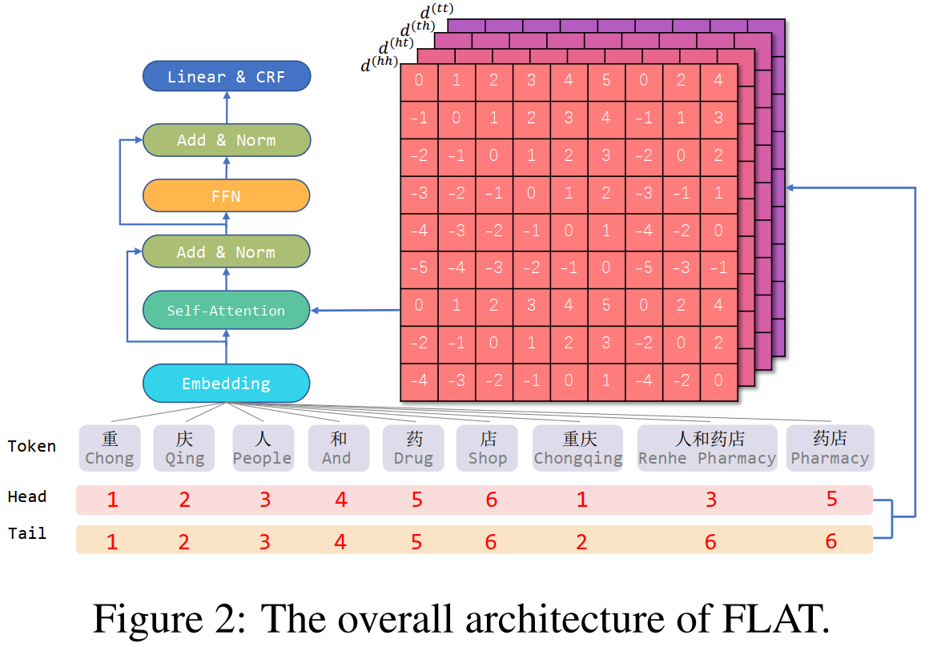
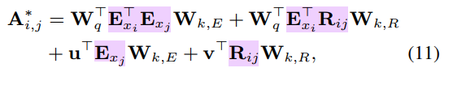
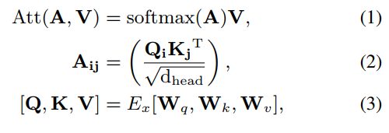
Model
Relative Position Encoding of Spans
加入相对位置编码的self-attention：
Transformer（仅一层）：
输出字符的representation，之后过CRF。
Condiftional Random Field (CRF)
Notes:
the token which has the same head and tail, to construct the character sequence. Then we use other tokens (words) with their heads and tails to build skip-paths.
Since our transformation is recoverable, we assume flat-lattice can maintain the original structure of lattice

Slide 9
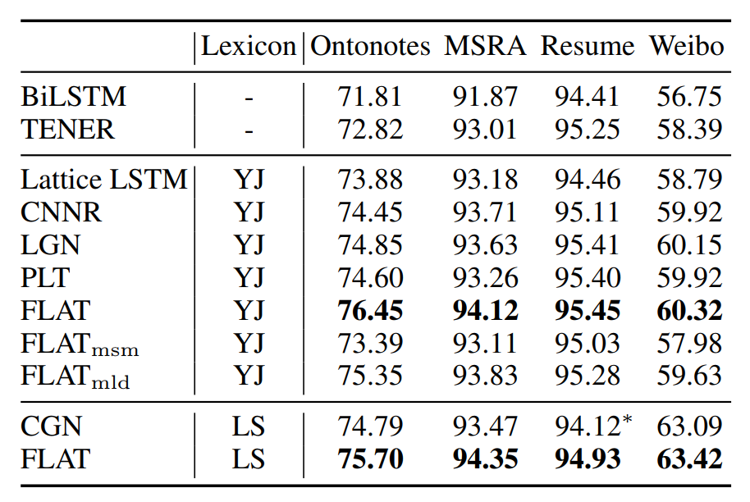
Experiments
1.72
1.51
0.73
FLAT outperforms baseline models and other lexicon-based models on four Chinese NER datasets.
Notes:
Subscripts ‘msm’ and ‘mld’ denote FLAT with the mask of self-matched words and long distance (>10), respectively
self-matched words of “药 (Drug)” are “人和药 店(Renhe Pharmacy)” and “药店 (Pharmacy)”

Slide 10
Experiments
Advantage of Fully-Connected Structure
Compared with lattice LSTM ： 1) All characters can directly interact with its self-matched words.
2)Long-distance dependencies can be fully modeled.
In detail, we mask attention from the character to its self-matched word and attention between tokens whose distance exceeds 10：
the first mask brings a significant deterioration to FLAT while the second degrades performance slightly

Slide 11
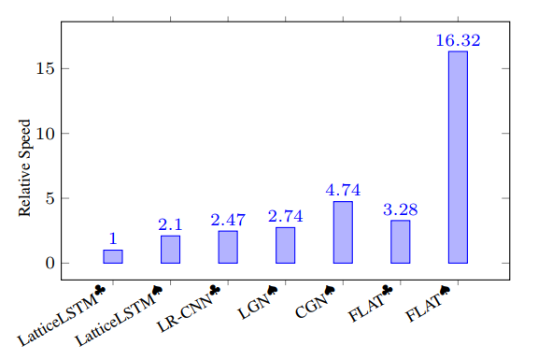
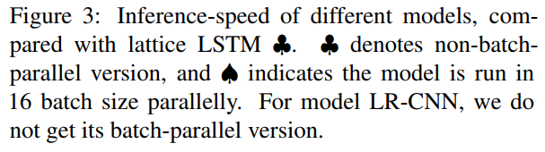
Experiments
Efficiency of FLAT
we compare the inference-speed of different lexicon-based models on Ontonotes.
Because our model has no recurrent module and can fully leverage parallel computation of GPU, it outperforms other methods in running efficiency.

Slide 12
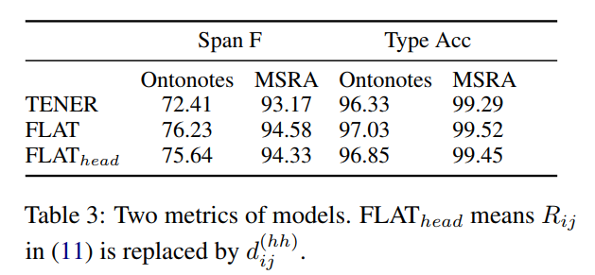
Experiments
How FLAT Brings Improvement
Compared with TENER, FLAT leverages lexicon resources and a new position encoding
FLAT outperforms TENER in two metrics significantly.
The improvement on Span F brought by FLAT is more significant than that on Type Acc.
Compared to FLAT, FLAThead’s deterioration on Span F is more significant than that on Type Acc.
FLAT locate entities more accurately
The pre-trained word-level embedding
Notes:
1) Span F: while the common F score used in NER considers correctness of both the span and the entity type, Span F only considers the former. 2) Type Acc: proportion of full-correct predictions to span-correct predictions.

Slide 13
Conclusion
In this paper, we introduce a flat-lattice Transformer to incorporate lexicon information for Chinese NER.
The core of our model is converting lattice structure into a set of spans and introducing the specific position encoding.

